Slide 1
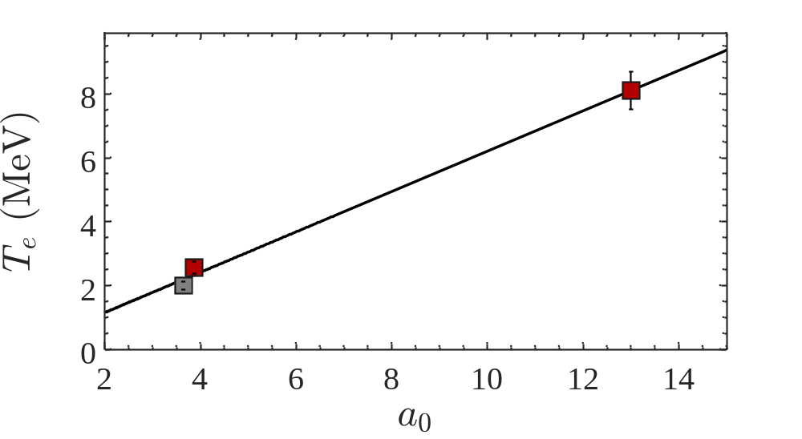
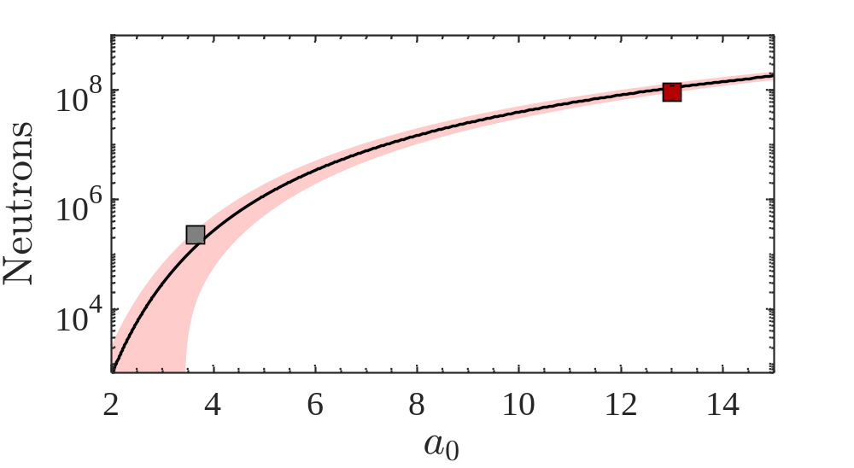
ELI
(This work)
SNRC (This work)
Cohen (2024)
ELI
(This work)
Cohen
(2024)

